Slide 1
GenOsc
function generator + oscilloscope

Slide 2
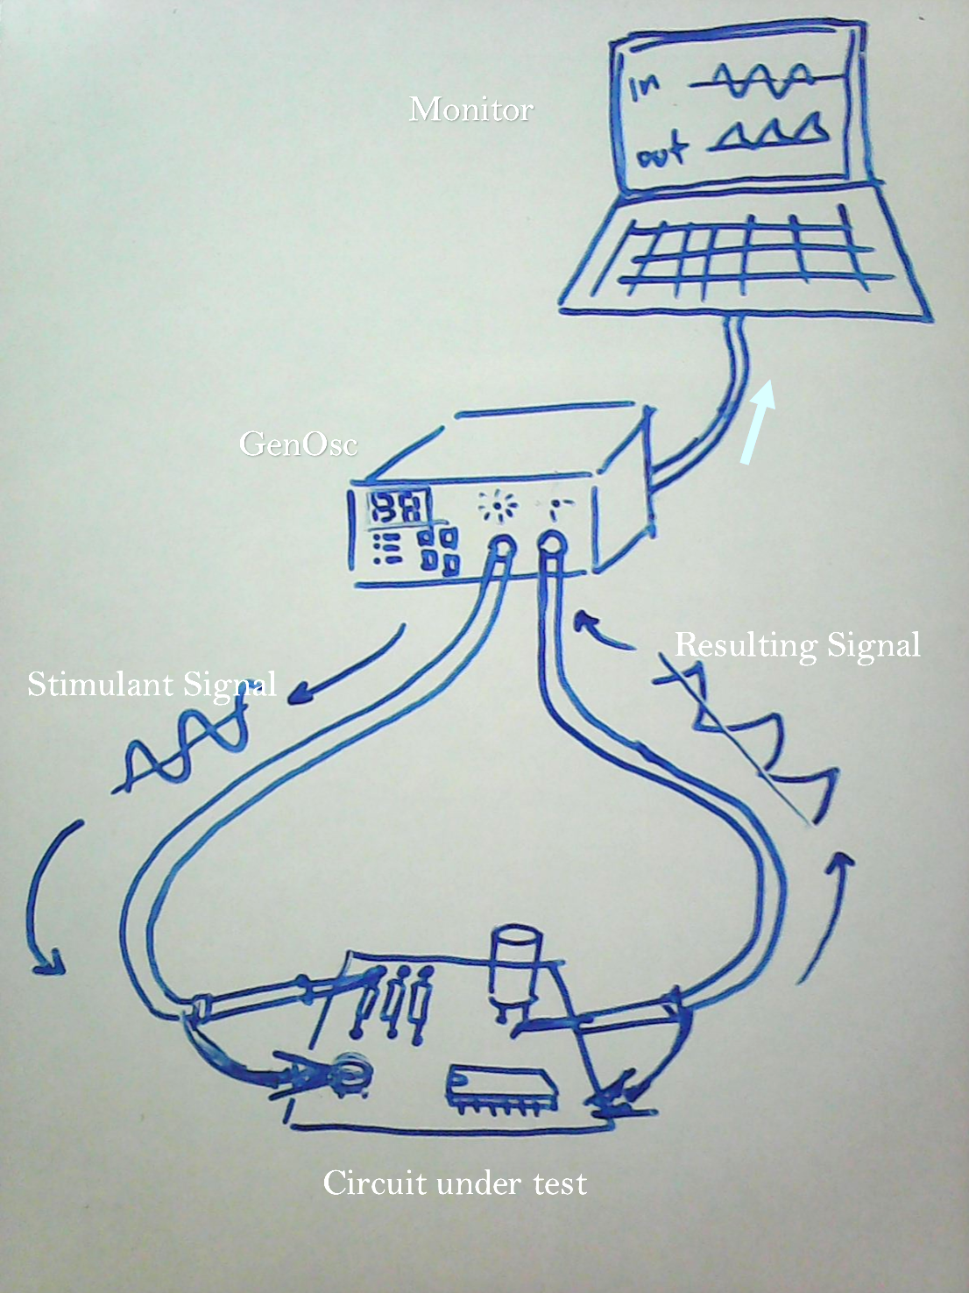

Slide 3
Why build GenOsc?

Slide 4
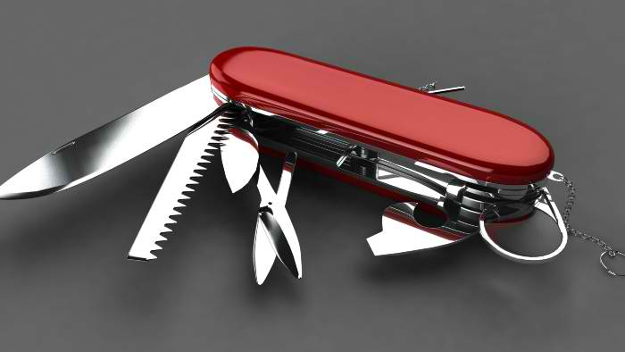
Portability

Slide 5
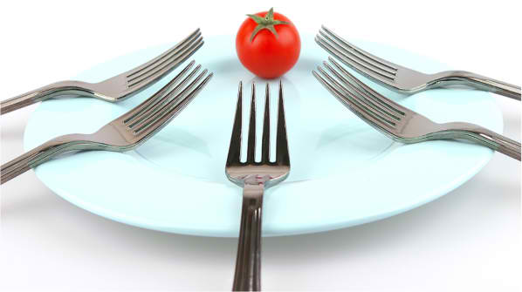
Equipment-to-student ratio

Slide 6
Have you used a function generator before?
Yes | 4.12%
No | 95.29%
Abstain | 0.59%

Slide 7
Have you used an oscilloscope before?
Yes | 2.35%
No | 97.06%
Abstain | 0.59%

Slide 8
Perception of function gen’s importance
Very important | 45.29%
Important | 34.12%
A little Important | 1.76%
Not important at all| 7.06%
Abstain| 11.76%

Slide 9
Perception of oscilloscope’s importance
Very important | 50%
Important | 31.18%
A little Important | 0.59%
Not important at all| 0%
Abstain| 18.24%

Slide 10

Encourages learning

Slide 11
After using GenOsc, were you encouraged
to further explore and utilize a Function Generator to experiment with circuits?
Very encouraged | 50.59%
Encouraged | 35.29%
A little encouraged | 7.06%
Not encouraged at all| 3.53%
Abstain| 3.53%

Slide 12
After using GenOsc, were you encouraged
to further explore and utilize an Oscilloscope to experiment with circuits?
Very encouraged | 48.24%
Encouraged | 37.06%
A little encouraged | 8.24%
Not encouraged at all| 3.53%
Abstain| 2.94%

Slide 13
How effective is GenOsc as a learning equipment?
Very effective | 61.18%
Effective | 37.06%
A little effective | 0%
Not effective at all| 0%
Abstain| 1.76%

Slide 14
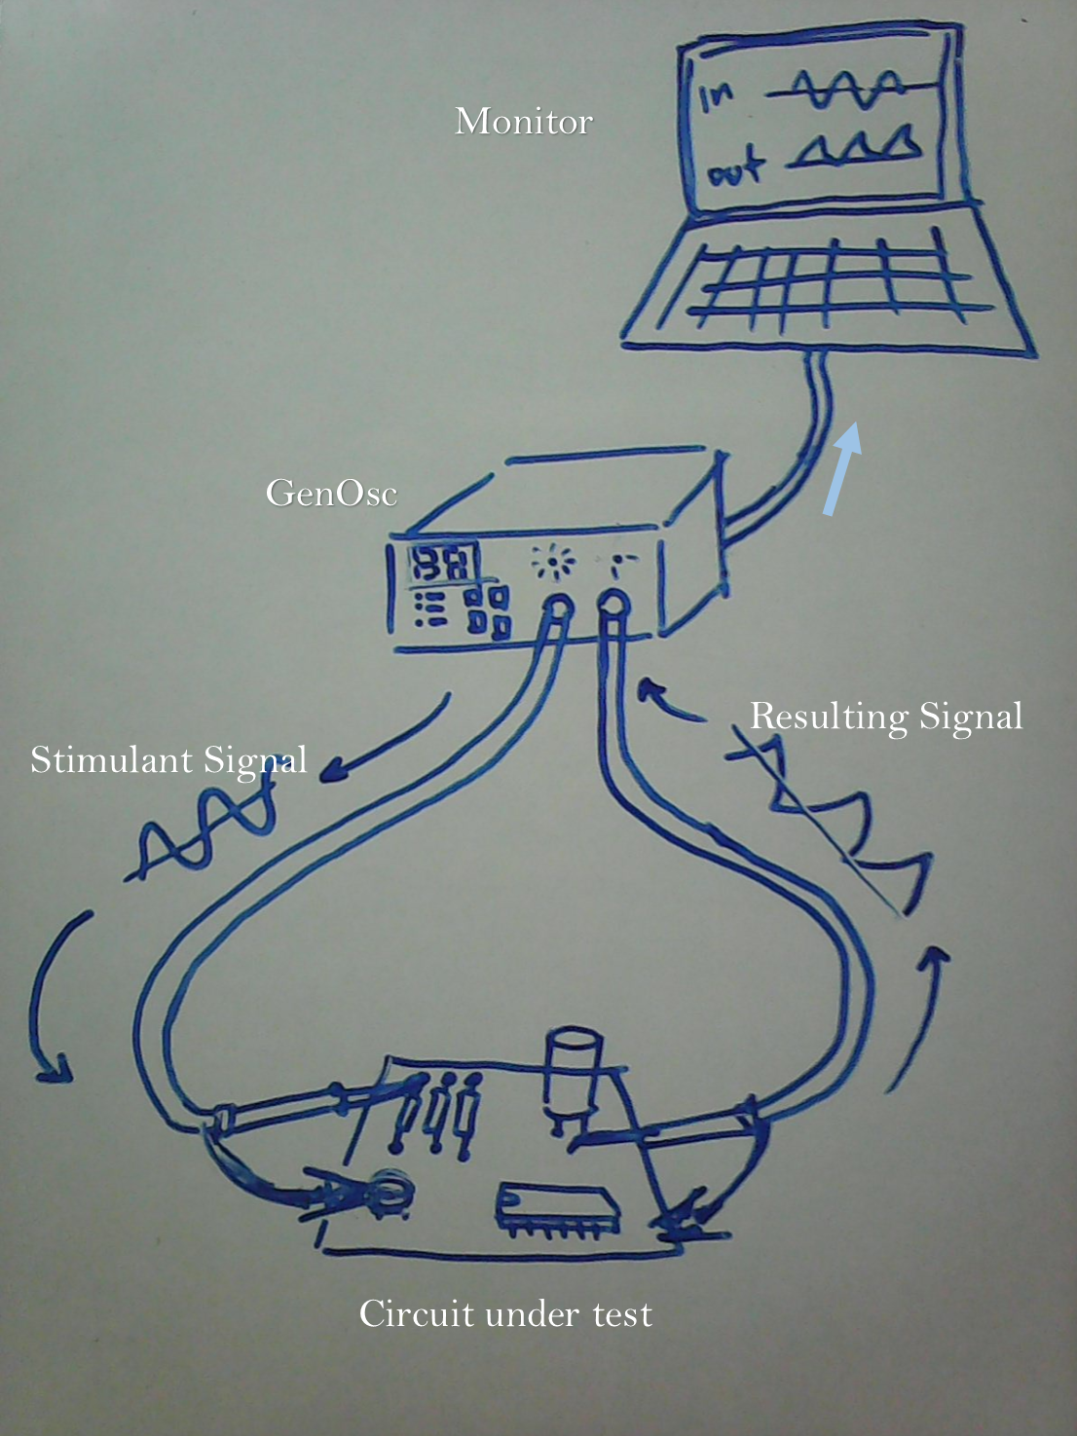
Behind the scene

Slide 15
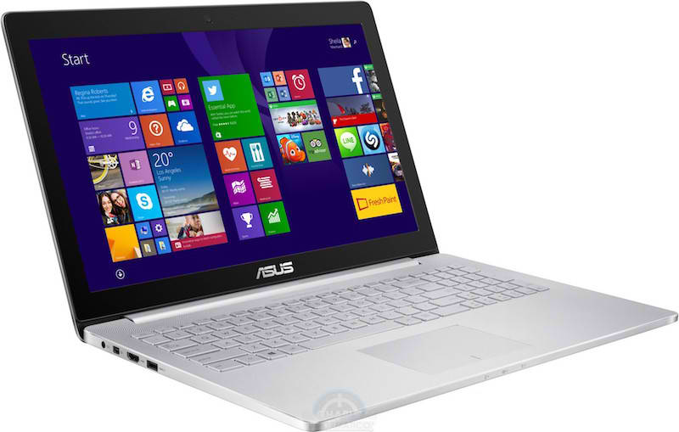
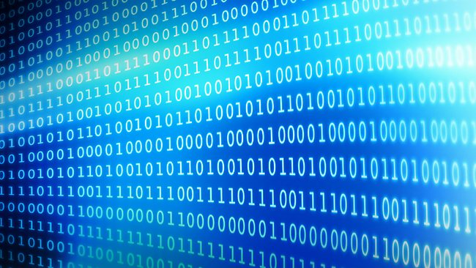
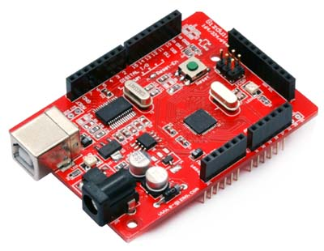
1) Send instructions
- wave selection
- frequency
- duty cycle

Slide 16
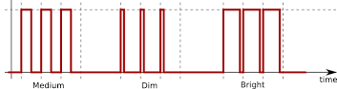
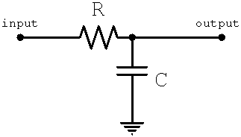
2) Generate PWM and feed into a LPF

Slide 17
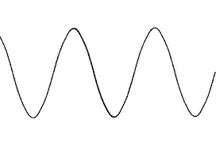
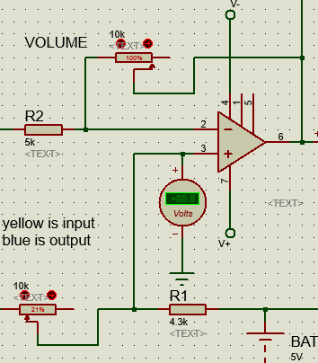
3) Fine tuning thru a control circuit

Slide 18
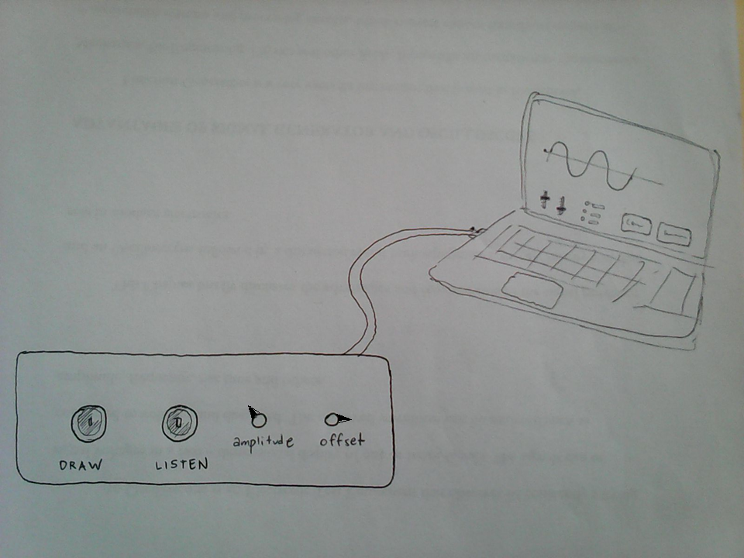
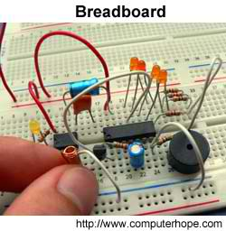
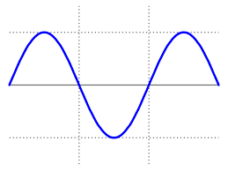
4) Output Waveform

Slide 19
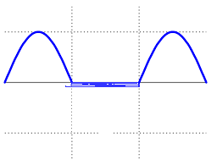
5) Input Waveform

Slide 20
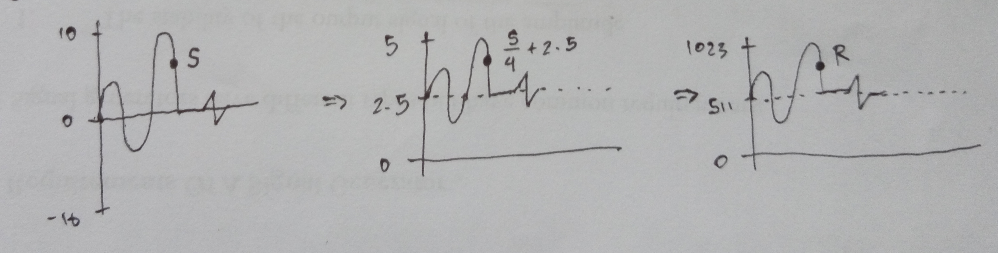
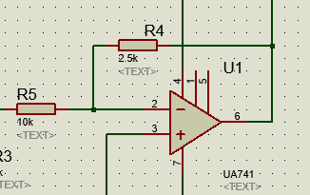
6) Receiving adaptation circuit

Slide 21
7) Data communication

Slide 22
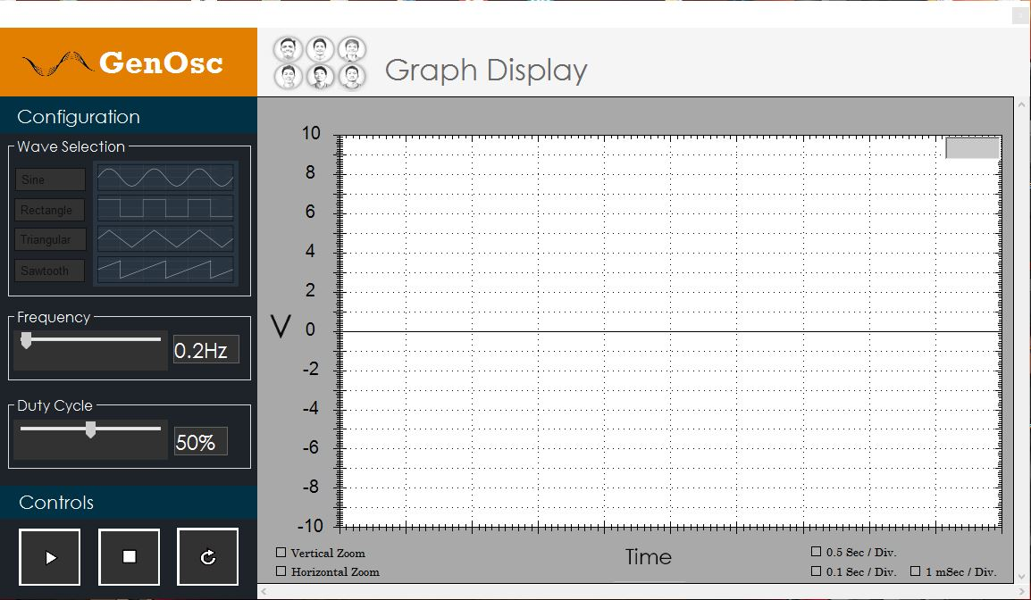
Windows Form Application Visual C#
Notes:
Good afternoon po sa lahat ng panelist, The listen part is composed of a software program. It is a Windows Form Application mainly to create a windows forms user interface written in C# programming language. Okay po, ngayon ipepresent ko naman po sa inyo kung papaanno ang aming software program mag work. next slide.

Slide 23
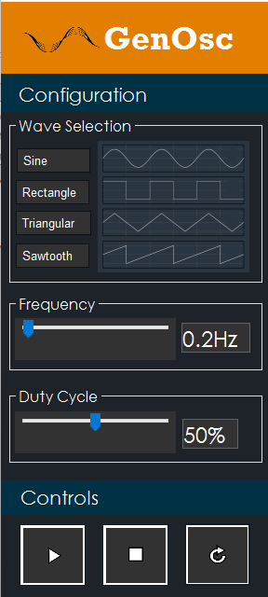
Wave button selections
Sample Wave Pictures
Frequency Trackbar
(0.1Hz - 100Hz)
Frequency Text Label
Duty Cycle Trackbar
(0% - 100%)
Duty Cycle Text Label
Start Button
(Initialize connection to Arduino)
Restart Button
Stop Button
(Close the connection to Arduino)
Notes:
ok po, so lets focus on how we will set up our GenOsc/Function Generator and Oscilloscope. There are two sets of buttons, Configuration and Controls.

Slide 24
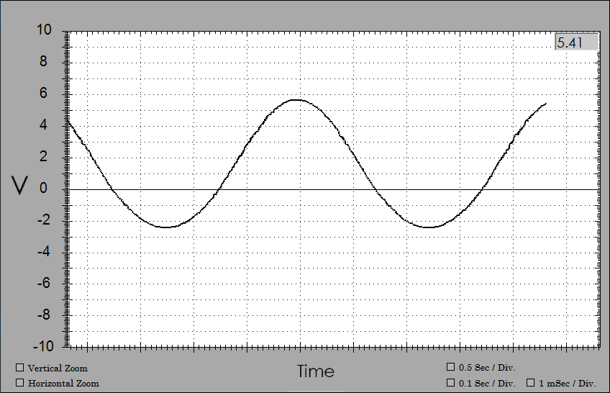
Instantaneous
Voltage reading
Time Division Selection
Zoom Toggle

Slide 25
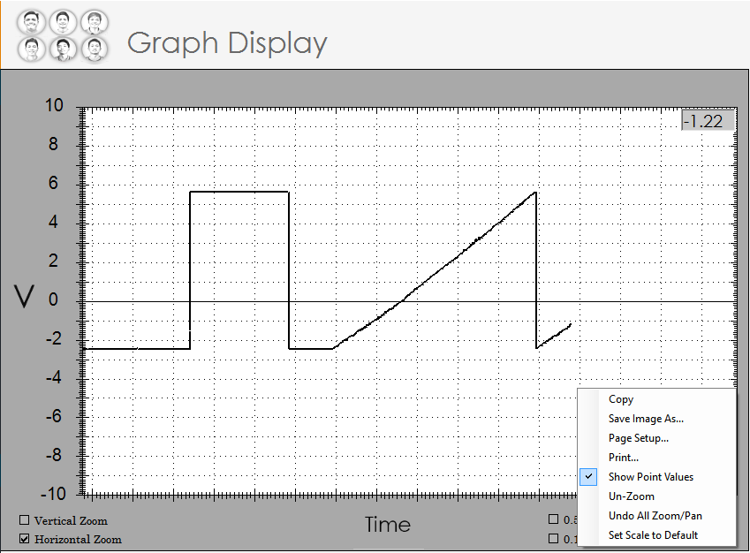
This is me.

Slide 26
Anatomy of GenOsc

Slide 27
demonstration

